Slide 1
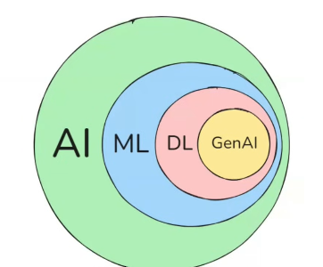

π
Langchain
Basics
Langchain
Caching LLM Response
Streaming
PromptTemplate | ChatPromptTemplate
Langchain Component
Indexes
Notes:
Content: https://www.linkedin.com/pulse/chunking-strategies-ai-data-kash-kashyap-0lghe/

Slide 2
Langchain
Notes:
Content: https://www.linkedin.com/pulse/chunking-strategies-ai-data-kash-kashyap-0lghe/

Slide 3
Any LLM App
is LLM Model
Langchain does not have any llm model .it just provide standard interface that interacting with LLM including OpenAI GP,Google Gemini, Facebook Ollama ,Anthropic Sonnet
In Langchain terminology these are called LLM Provide
Requirements.txt
It we install multiple package at once ,we need to put package in requirements txt file and execute below command
Model Output
pip install –r requirements.txt
content
Print( outupt.content )

Slide 4
Langchain Use-Cases
Chat Bots
Question Answering Systems
Summarization Tools
Notes:
Content: https://www.linkedin.com/pulse/chunking-strategies-ai-data-kash-kashyap-0lghe/

Slide 5
Langchain Main Concepts
1. Langchain Components
2. Chains
3. Agents
Langchain Components
1. LLM Wrapper
2. Prompt Templates
3. Indexes
4. Memory
Memory: short term and long term memory
Notes:
Content: https://www.linkedin.com/pulse/chunking-strategies-ai-data-kash-kashyap-0lghe/

Slide 6
Chat Models
In Langchain when we are working with
- invoke
- stream
- batch
Then we always rely on officinal document for help
But if we need information or help while using classes in python environment,
we would typically use python’s built in help functionality
help( ChatGoogleGenerativeAI )
Notes:
Content: https://www.linkedin.com/pulse/chunking-strategies-ai-data-kash-kashyap-0lghe/

Slide 7
Langchain Agents
Agents facilitate interaction between the LLM (Large Language Model) and external APIs. They play a crucial role in decision-making, determining which actions the LLM should undertake.
This process involves:
Taking an action
Observing the result
Repeating the cycle until completion
Notes:
Content: https://www.linkedin.com/pulse/chunking-strategies-ai-data-kash-kashyap-0lghe/

Slide 8
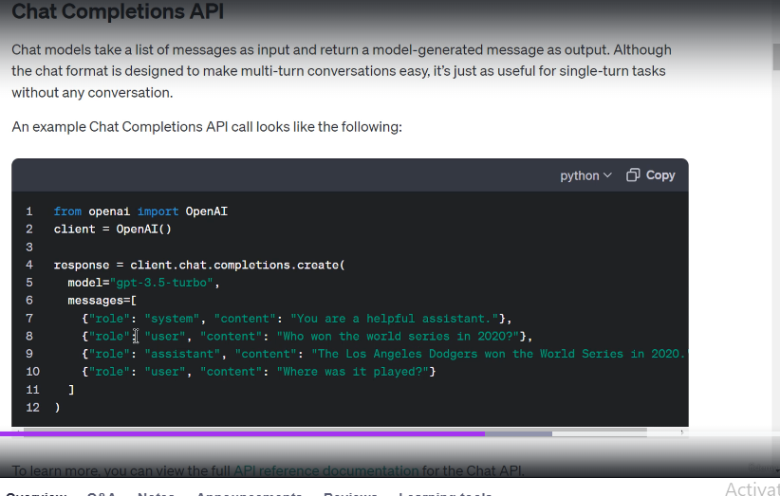
The OpenAI API for GPT 3.5 turbo, GPT for GPT four turbo, and so on uses a list of dictionaries called messages.
These messages define three roles
system,
user, and
assistant.
The system role helps set the behavior of the assistant.
The user message serves as the prompt or the question we ask the assistant and the assistant messages.
Notes:
Content: https://www.linkedin.com/pulse/chunking-strategies-ai-data-kash-kashyap-0lghe/

Slide 9
When calling the LMM from Lang chain, we need to import a schema for the messages from Lang chain schema.
Notes:
Content: https://www.linkedin.com/pulse/chunking-strategies-ai-data-kash-kashyap-0lghe/

Slide 10
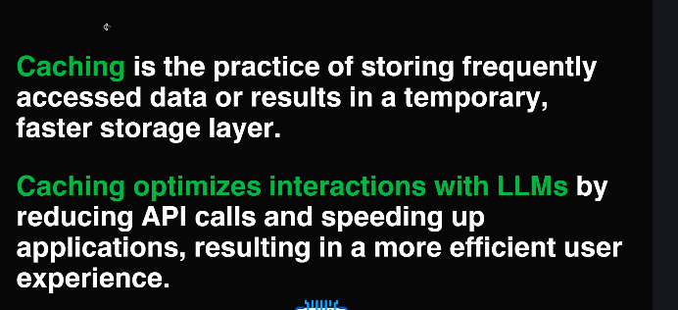
Caching LLM Response
In the context of long chain caching helps optimize interactions with the LMS.
It matters because it reduces API calls and speeds up applications.
When you repeatedly request the same completion from an LM, caching ensures that the result is stored locally.
Subsequent requests for the same input can then be served directly from the cache, reducing the number
of expensive API calls to the LM provider by avoiding redundant API calls.
Caching significantly speeds up your application whether you are building chat box content generators,
Faster responses enhance the user experience.
Notes:
Content: https://www.linkedin.com/pulse/chunking-strategies-ai-data-kash-kashyap-0lghe/

Slide 11
Link chain provides an optional caching layer for LLM and there are two caching options
in-memory cache and SQLite cache.
%%time is a Jupyter Notebook magic command (not standard Python).
It measures the execution time of an entire cell.
When you run a cell with %%time at the very top, Jupyter reports:
CPU time → how long the processor worked.
Wall time → the actual elapsed time (including waiting, I/O, etc.).
%time → times a single line of code.
%%time → times the whole cell.
So, %%time is your stopwatch for an entire cell in Jupyter.
Notes:
Content: https://www.linkedin.com/pulse/chunking-strategies-ai-data-kash-kashyap-0lghe/

Slide 12
from langchain_google_genai import ChatGoogleGenerativeAI
from langchain.globals import set_llm_cache
llm = ChatGoogleGenerativeAI(model="gemini-2.5-flash")
from langchain.cache import InMemoryCache
set_llm_cache(InMemoryCache())
output=llm.invoke("what is 2june 1986 week day?")
from langchain.cache import SQLiteCache
set_llm_cache(SQLiteCache(database_path="llm_cache.db"))
output=llm.invoke("what is 2june 1986 week day?")
print(output.content)
Notes:
Content: https://www.linkedin.com/pulse/chunking-strategies-ai-data-kash-kashyap-0lghe/

Slide 13
Streaming refers to the process of delivering the response in a continuous stream of data instead of sending the entire response at once.
This allows the user to receive the response piece by piece as it is generated, which can improve the user experience and reduce the overall latency.
Notes:
Content: https://www.linkedin.com/pulse/chunking-strategies-ai-data-kash-kashyap-0lghe/

Slide 14
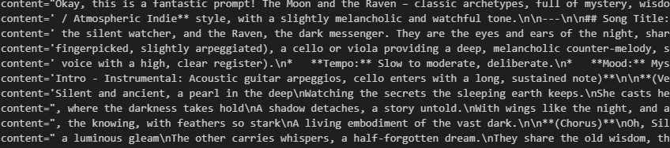
from langchain_google_genai import ChatGoogleGenerativeAI
llm = ChatGoogleGenerativeAI(model="gemini-2.5-flash")
for chunk in llm.stream("tell me a song for moon and raven"):
print(chunk , end='\n‘ ,flush=True)
for event in events: print(event)
for event in events: print(event)
for event in events: print(event)
for event in events: print(event)
for event in events: print(event)
for event in events: print(event)
for event in events: print(event)
for event in events: print(event)
app.stream(...)
→ runs the compiled graph but instead of returning a single result, it yields outputs step‑by‑step as a generator
You can iterate over events to handle each piece of output:
for event in events:
print(event)
This will print each streamed value as the graph executes.
Notes:
Content: https://www.linkedin.com/pulse/chunking-strategies-ai-data-kash-kashyap-0lghe/

Slide 15
PromptTemplate
A prompt refers to the input to the model.
Prompt templates are a way to create dynamic prompts for LLM that are more flexible and easier to use than traditional static prompts.
A prompt template takes a piece of text and injects a user's input into that piece of text.
Note that in Lang Chain there are
PromptTemplate and
ChatPromptemplate.
Prompt templates are used for tasks that involve generating text, such as answering questions or completing sentences.
While chat prompt templates are specifically designed for tasks that involve engaging in conversations.
Notes:
Content: https://www.linkedin.com/pulse/chunking-strategies-ai-data-kash-kashyap-0lghe/

Slide 16
This is similar to an F-string and uses curly braces for the dynamic part of the template. Curly braces is called placeholder
from langchain.prompts import PromptTemplate
llm = ChatGoogleGenerativeAI(model="gemini-2.5-flash")
template="what is the week day of {date}?"
prompt_template=PromptTemplate.from_template(template)
prompt=prompt_template.format(date="8june 1986")
output=llm.invoke(prompt)
print(output.content)
Notes:
Content: https://www.linkedin.com/pulse/chunking-strategies-ai-data-kash-kashyap-0lghe/

Slide 17
ChatPromptTemplate
PromptTemplate handles single-string prompts for basic LLM tasks, while ChatPromptTemplate structures multi-message, multi-role conversations (system, human, AI) for chat models, using specific message objects like SystemMessage, HumanMessage, and AIMessage to build context-aware dialogues. The key difference is structure: PromptTemplate is for simple string inputs, ChatPromptTemplate uses a list of typed messages for complex chat flows.
PromptTemplate
Purpose: Ideal for simple text generation or completion tasks where the input is a single string.
Input: Takes a single string template with placeholders (e.g., {topic}).
Example Use: Generating a summary, translating a sentence.
# Simplified Example
from langchain_core.prompts import PromptTemplate
prompt = PromptTemplate.from_template("Tell me a joke about {topic}")
# Use: prompt.format(topic="cats")
Notes:
Content: https://www.linkedin.com/pulse/chunking-strategies-ai-data-kash-kashyap-0lghe/

Slide 18
ChatPromptTemplate
Purpose: Designed for multi-turn conversations and chat-based applications.
Input: A list of template messages, each with a role (system, human, AI) and content.
Example Use: Building Chatbot, managing dialogue history.
Notes:
Content: https://www.linkedin.com/pulse/chunking-strategies-ai-data-kash-kashyap-0lghe/

Slide 19
from langchain.prompts import PromptTemplate,ChatPromptTemplate,HumanMessagePromptTemplate,SystemMessagePromptTemplate
from langchain_google_genai import ChatGoogleGenerativeAI
llm = ChatGoogleGenerativeAI(model="gemini-2.5-flash")
chat_template=ChatPromptTemplate.from_messages([
SystemMessagePromptTemplate.from_template("You are a helpful assistant that translates {input_language} to {output_language}."),
HumanMessagePromptTemplate.from_template("{text}")
])
messages=chat_template.format_prompt(input_language="English",output_language="hindi",text="I love programming.")
output=llm.invoke(messages)
output.content
'मुझे प्रोग्रामिंग बहुत पसंद है।'
Notes:
Content: https://www.linkedin.com/pulse/chunking-strategies-ai-data-kash-kashyap-0lghe/

Slide 20
6.Agents
1.Models
Langchain
5.Indexes
2.Prompts
4.Memory
3.Chains
LangChain Components
Notes:
Content: https://www.linkedin.com/pulse/chunking-strategies-ai-data-kash-kashyap-0lghe/

Slide 21
Langchain
(Communicate two models Language model/Embedding model)
Language models
Embedding model
LLMS
text
vector(output)
text
text
semantic
Notes:
Content: https://www.linkedin.com/pulse/chunking-strategies-ai-data-kash-kashyap-0lghe/

Slide 22
Indexes
Indexes are used to connect applications to external knowledge sources—such as PDFs, websites, or databases.
1
Doc Loader
2
Text splitter
PDF
upload
AWS S3
3
Vector store
4
retriever
Doc Loader
page1
Embedding1
An index is created by combining these four elements
PDF
Page2
Embedding2
Text splitter
Page3
Embedding3
Page 100
Embedding 100
DB
vectorstore
retriever
System query
User query
Embedding
Semantic search
pages
User
query
Embedding
Notes:
Content: https://www.linkedin.com/pulse/chunking-strategies-ai-data-kash-kashyap-0lghe/

Slide 23
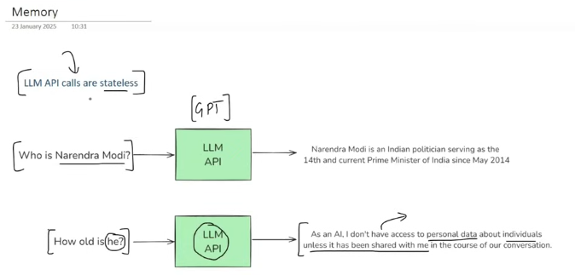
Notes:
Content: https://www.linkedin.com/pulse/chunking-strategies-ai-data-kash-kashyap-0lghe/

Slide 24
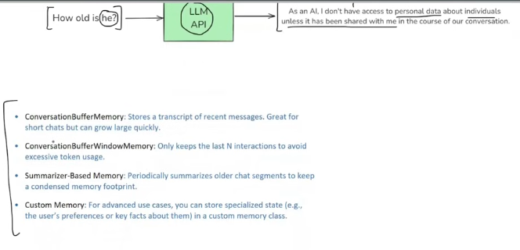
Notes:
Content: https://www.linkedin.com/pulse/chunking-strategies-ai-data-kash-kashyap-0lghe/

Slide 25
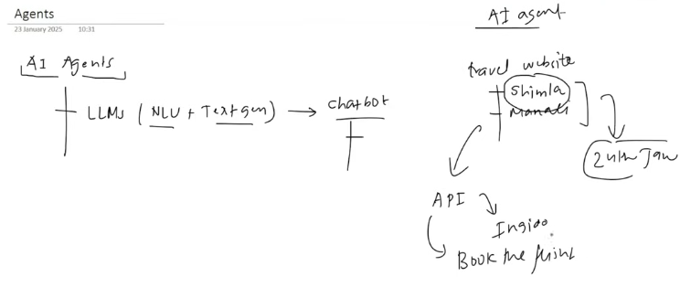
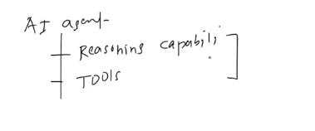
Notes:
Content: https://www.linkedin.com/pulse/chunking-strategies-ai-data-kash-kashyap-0lghe/

Slide 26
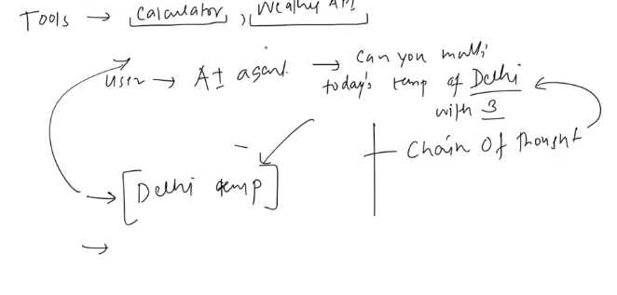
Notes:
Content: https://www.linkedin.com/pulse/chunking-strategies-ai-data-kash-kashyap-0lghe/

Slide 27
Notes:
Content: https://www.linkedin.com/pulse/chunking-strategies-ai-data-kash-kashyap-0lghe/

Slide 28
Notes:
Content: https://www.linkedin.com/pulse/chunking-strategies-ai-data-kash-kashyap-0lghe/

Slide 29
Notes:
Content: https://www.linkedin.com/pulse/chunking-strategies-ai-data-kash-kashyap-0lghe/

